Slide 1
BIP 9 - LINK
Version Bits with Timeout and Delay

Slide 2

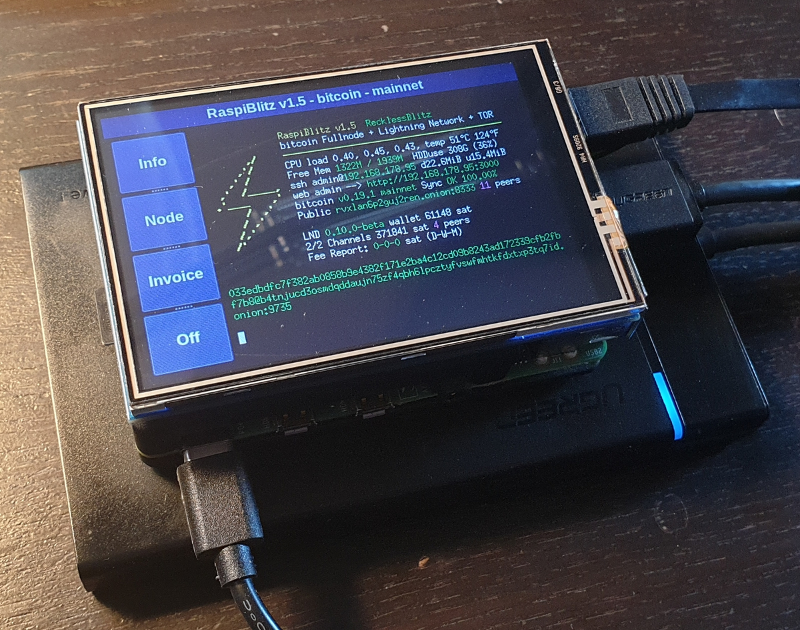
DISCLAIMER - ⚠️Potentially Contentious ⚠️
BIP 9 Places the power of a soft fork activation in with the miners (nodes with hashpower)
BIP 8 drafts a replacement for BIP 9 - NOT ‘FINAL’
Speedy Trial Activation
Pure and simple it involves consensus regarding the implementation of 1 or more softfork(s)
VS.
&

Slide 3
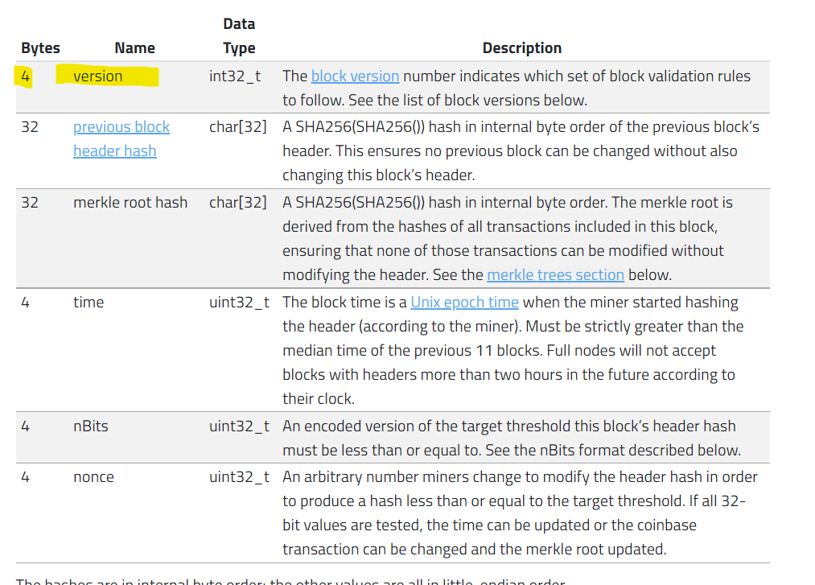
Version Bits in a Bitcoin Block - Where are they?
The version is the first item included in a bitcoin block, block header - These version bits are signals used by miners signaling to nodes what consensus rules are compatible (or potentially incompatible.)
Soft forks should have no relevance to and older node, but signal additional features to newer nodes.

Slide 4

So what is a ‘Bit Vector’ and why is it important to BIP 9
All data in computer memory is arranged into a sequence of ‘0’s and ‘1’s these represent a True or False. With 0 usually meaning False and 1 meaning True.
‘Bit Vectors’ are a series of 0s and 1s such as ‘00000111’ where there the zeros mean something is False and the ones represent something is true. The best example that I can come up with is it’s similar to a light switch panel in your home. Each switch maps to one light and the light is on or off.
Each switch maps to one light, the number of active lights in the home would be equal to the number of switches in the on position. In our previous example of 00000111 that would mean the 5 switches on the left are off
and 3 on the right are on.
1
1
1
0
0
0
0
0

Slide 5
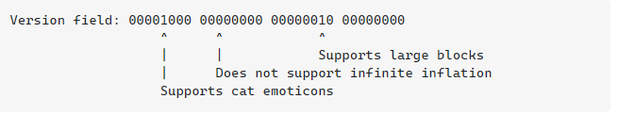
The Block Header Version Field Visualized
A series of 32 switches that can be turned on or off. Currently the first 3 switches on the left are (OFF OFF ON)
Example Version Field Source - https://bitcoin.stackexchange.com/a/39224

Slide 6
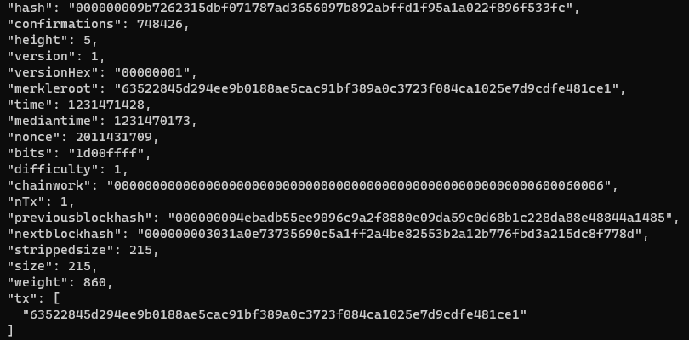
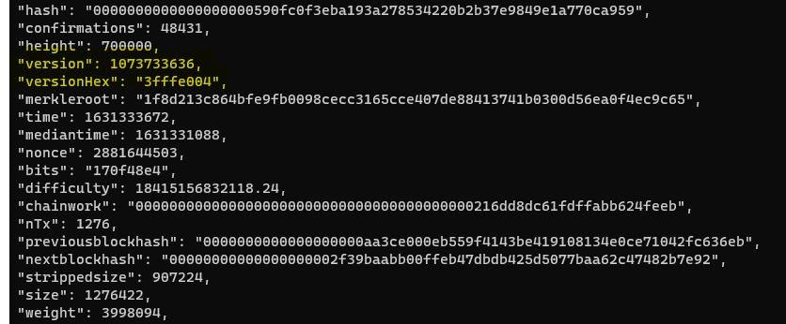
BIP 9 - Version Bits with Timeout and Delay - What is it?
BIP 9 is a method to use the version field of a blocks header to signal activation support of a softfork.
BIP 9 allows parallel softforks by representing each softfork via it’s own bit in the version field. A ‘bit vector` is the data structure used to store the version bits.
BIP9 RESERVED BITS
Used Version Number Portion …
ASIC BOOST MANGLING
ORIGINAL VERSION BITS
Block #5 Version = 32b’000….001
Block #700000 Version =32b’001111111111111110000000000100
SEGWIT AND CSV BITS
Version 1
Version 4

Slide 7
So how do BIP 9 and Soft forks convergere?
Since nodes without hashpower can’t effectively signal support for a soft fork and/or feature implementation in blocks. Nodes with hashpower are the primary signaling method for support of a soft fork. In the case of BIP 9. Soft forks are backwards compatible so the network of nodes with or without hashpower can reject these version flags and just not utilize the soft fork features.
BIP 9 essentially is a method for miners to signal in a block minted onto the timechain their support for a specific soft fork. Bip 9 due to the removal of using integer based versioning make it so miners can signal for multiple soft forks in parallel.

Slide 8
Motivation Summary - Improve on BIP34
BIP 34 - BIP 9 Fixes the inability to permanently reject a proposal
BIP 34 - BIP 9 Fixes need to coordinate soft fork proposals
BIP 34 - BIP 9 Removes the need to compare version numbers which limits it to one set of features per versions, flags in a bit vector allow for multiple features to be signaled in parallel.
BIP 34 - Creates unnecessary restrictions in the version bit field. Fix this with a ‘Bit Vector’ Implementation.

Slide 9
Specification
The proposed soft fork is coded into bitcoin core with the following data
Name
Bit Position
Start Time (time which the bit position gains meaning)
TImeout (if signaling ratio is not achieved the softfork is considered failed)

Slide 10
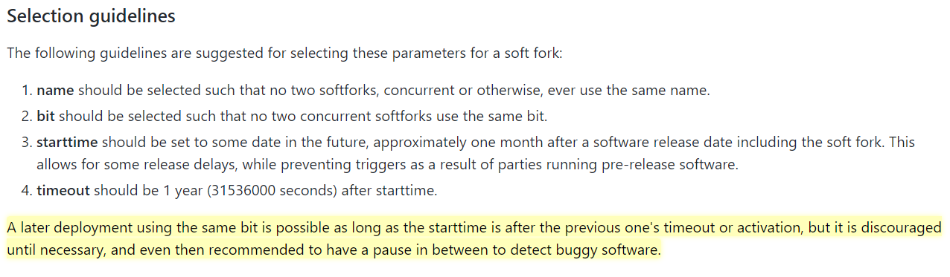
Selection continued… Gloss over this - Show for Clarity

Slide 11
Bit flag - Important but discussed earlier
Little endian representation
29 bits for flagging - 2 bits for future upgrades to different mechanisms
Miners ‘should’ continue setting the bit in LOCKED_IN so uptake is visible

Slide 12
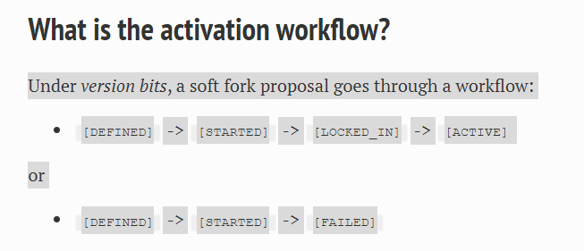
Only 2 Valid Work Flows - LOCKED_IN or FAILED

Slide 13
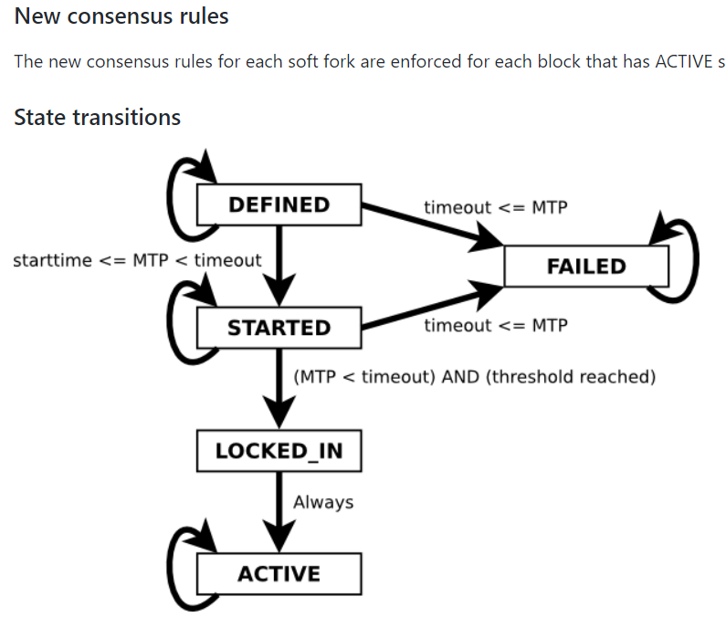
BIP 9 Consensus Rules
ACTIVATED VIA. BIP9
Segwit (BIT 1)
Check Sequence Verify (BIT 0)
During the started phase threshold counts for the signaled version bits are tallied together to move into the locked in phase.
>95% of miners signal during starting period for one difficulty adjustment to get the status of LOCKED_IN. 1 difficulty adjustment fixed to ACTIVE

Slide 14

Warnings to Clients
BIP 9 also expresses the use of a waning mechanism which when the soft fork(s) are locked in the client should announce loudly to the user. Then warn even more LOUDLY to the user that the softfork is in the active status.

Slide 15
Finally: Support For Future Changes.
Modified Thresholds - The threshold of BIPs 34s 95% doesn’t have to be maintained forever. Open to change lower or higher
Conflicting Soft forks - These can be handled with the completing soft forks excluding one another
Multistage Soft forks - These are supported by handling the bits as integers.

Slide 16
THANK YOU TO EVERYONE
NOTES:
I am human, there may be mistakes. Do not take this as the end all be all of this topic.
Please notify me of any mistakes right away
This is a technical analysis and does not cover the scope of actual implementation and consensus.
I hope everyone learned something.

Slide 17
Sources
https://github.com/bitcoin/bips/blob/master/bip-0009.mediawiki
https://bitcoincore.org/en/2016/06/08/version-bits-miners-faq
https://learnmeabitcoin.com/explorer/block/version/3fffe004
https://lists.linuxfoundation.org/pipermail/bitcoin-dev/2017-February/013643.html
https://github.com/bitcoin/bips/blob/master/bip-0148.mediawiki

